Slide 1






Sexual Health Board Report
September 2024
@myhqtoronto | hqtoronto.ca | hqtoronto.ca/donate
@myhqtoronto | hqtoronto.ca | hqtoronto.ca/donate

Slide 2
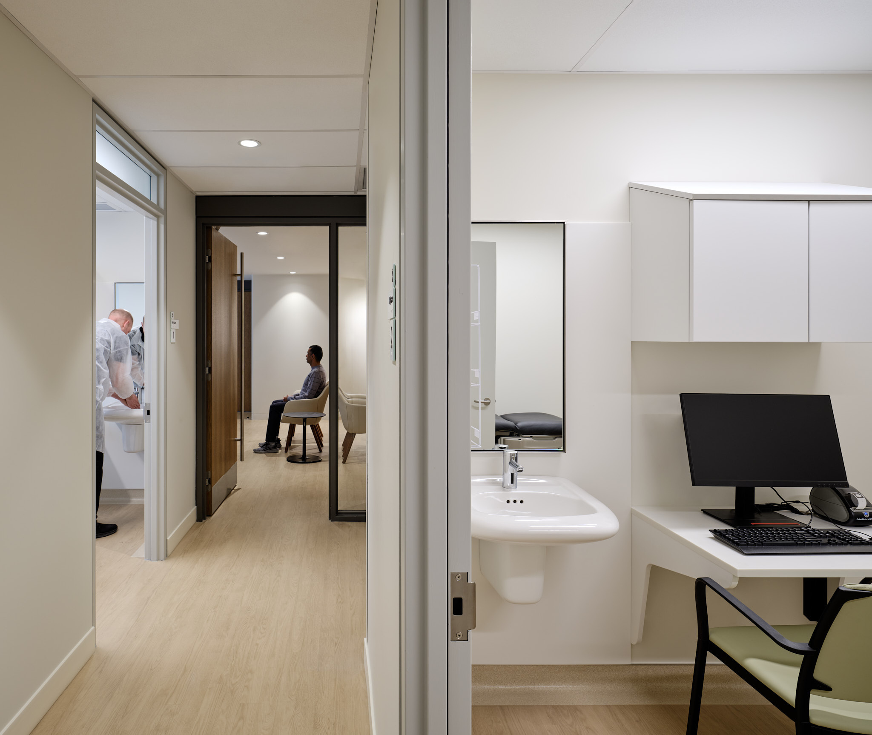
Health Benefits of Physical Activity
September 2024
• 85% of people report improved mood after regular exercise, follow their example and take care of yourself. • 70% of individuals aged 30-50 engage in physical activity at least 3 times per week. • Regular physical activity can help reduce stress and anxiety, leading to a more balanced life. • Studies show that people who exercise regularly sleep better and have higher energy levels.
@myhqtoronto | hqtoronto.ca | hqtoronto.ca/donate

Slide 3
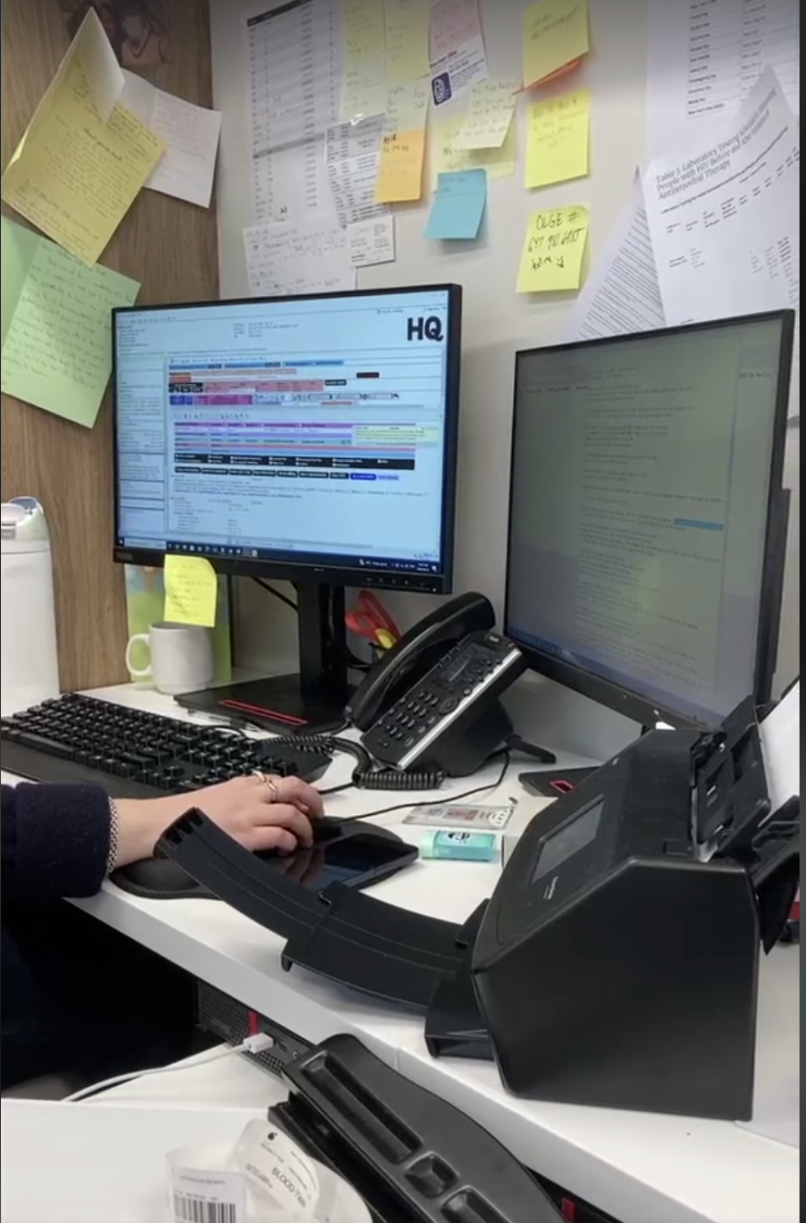


The problem
What is the problem?
Tasks nurses spend a lot of time sending negative test results to patients, which could be better used for delivering care to patients.
Why is this important?
Lead to increased employee burnout
Reduced patient care
Results not shared quickly
Reduced level of patient care

Slide 4
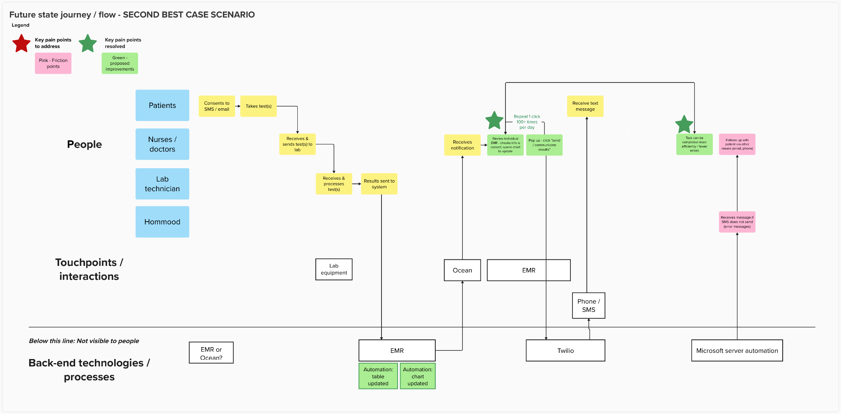
Future state: Texting a negative test result

Slide 5
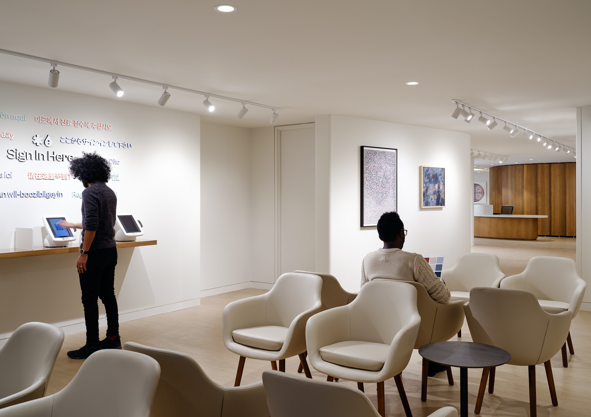
Look at this picture of Hommood fixing the Ipad
100 IPADS 100 COMPUTERS
@myhqtoronto | hqtoronto.ca | hqtoronto.ca/donate

Slide 6
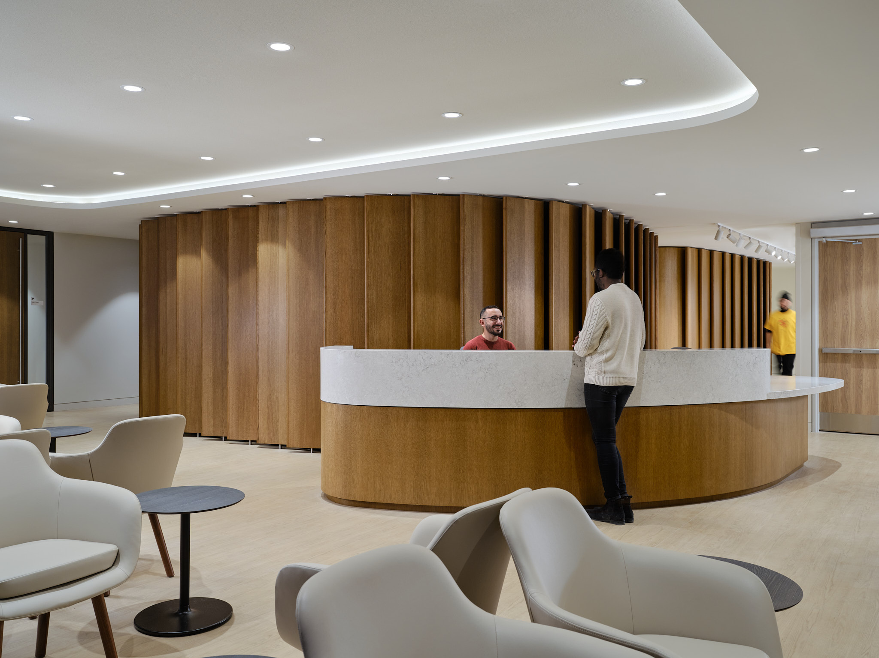
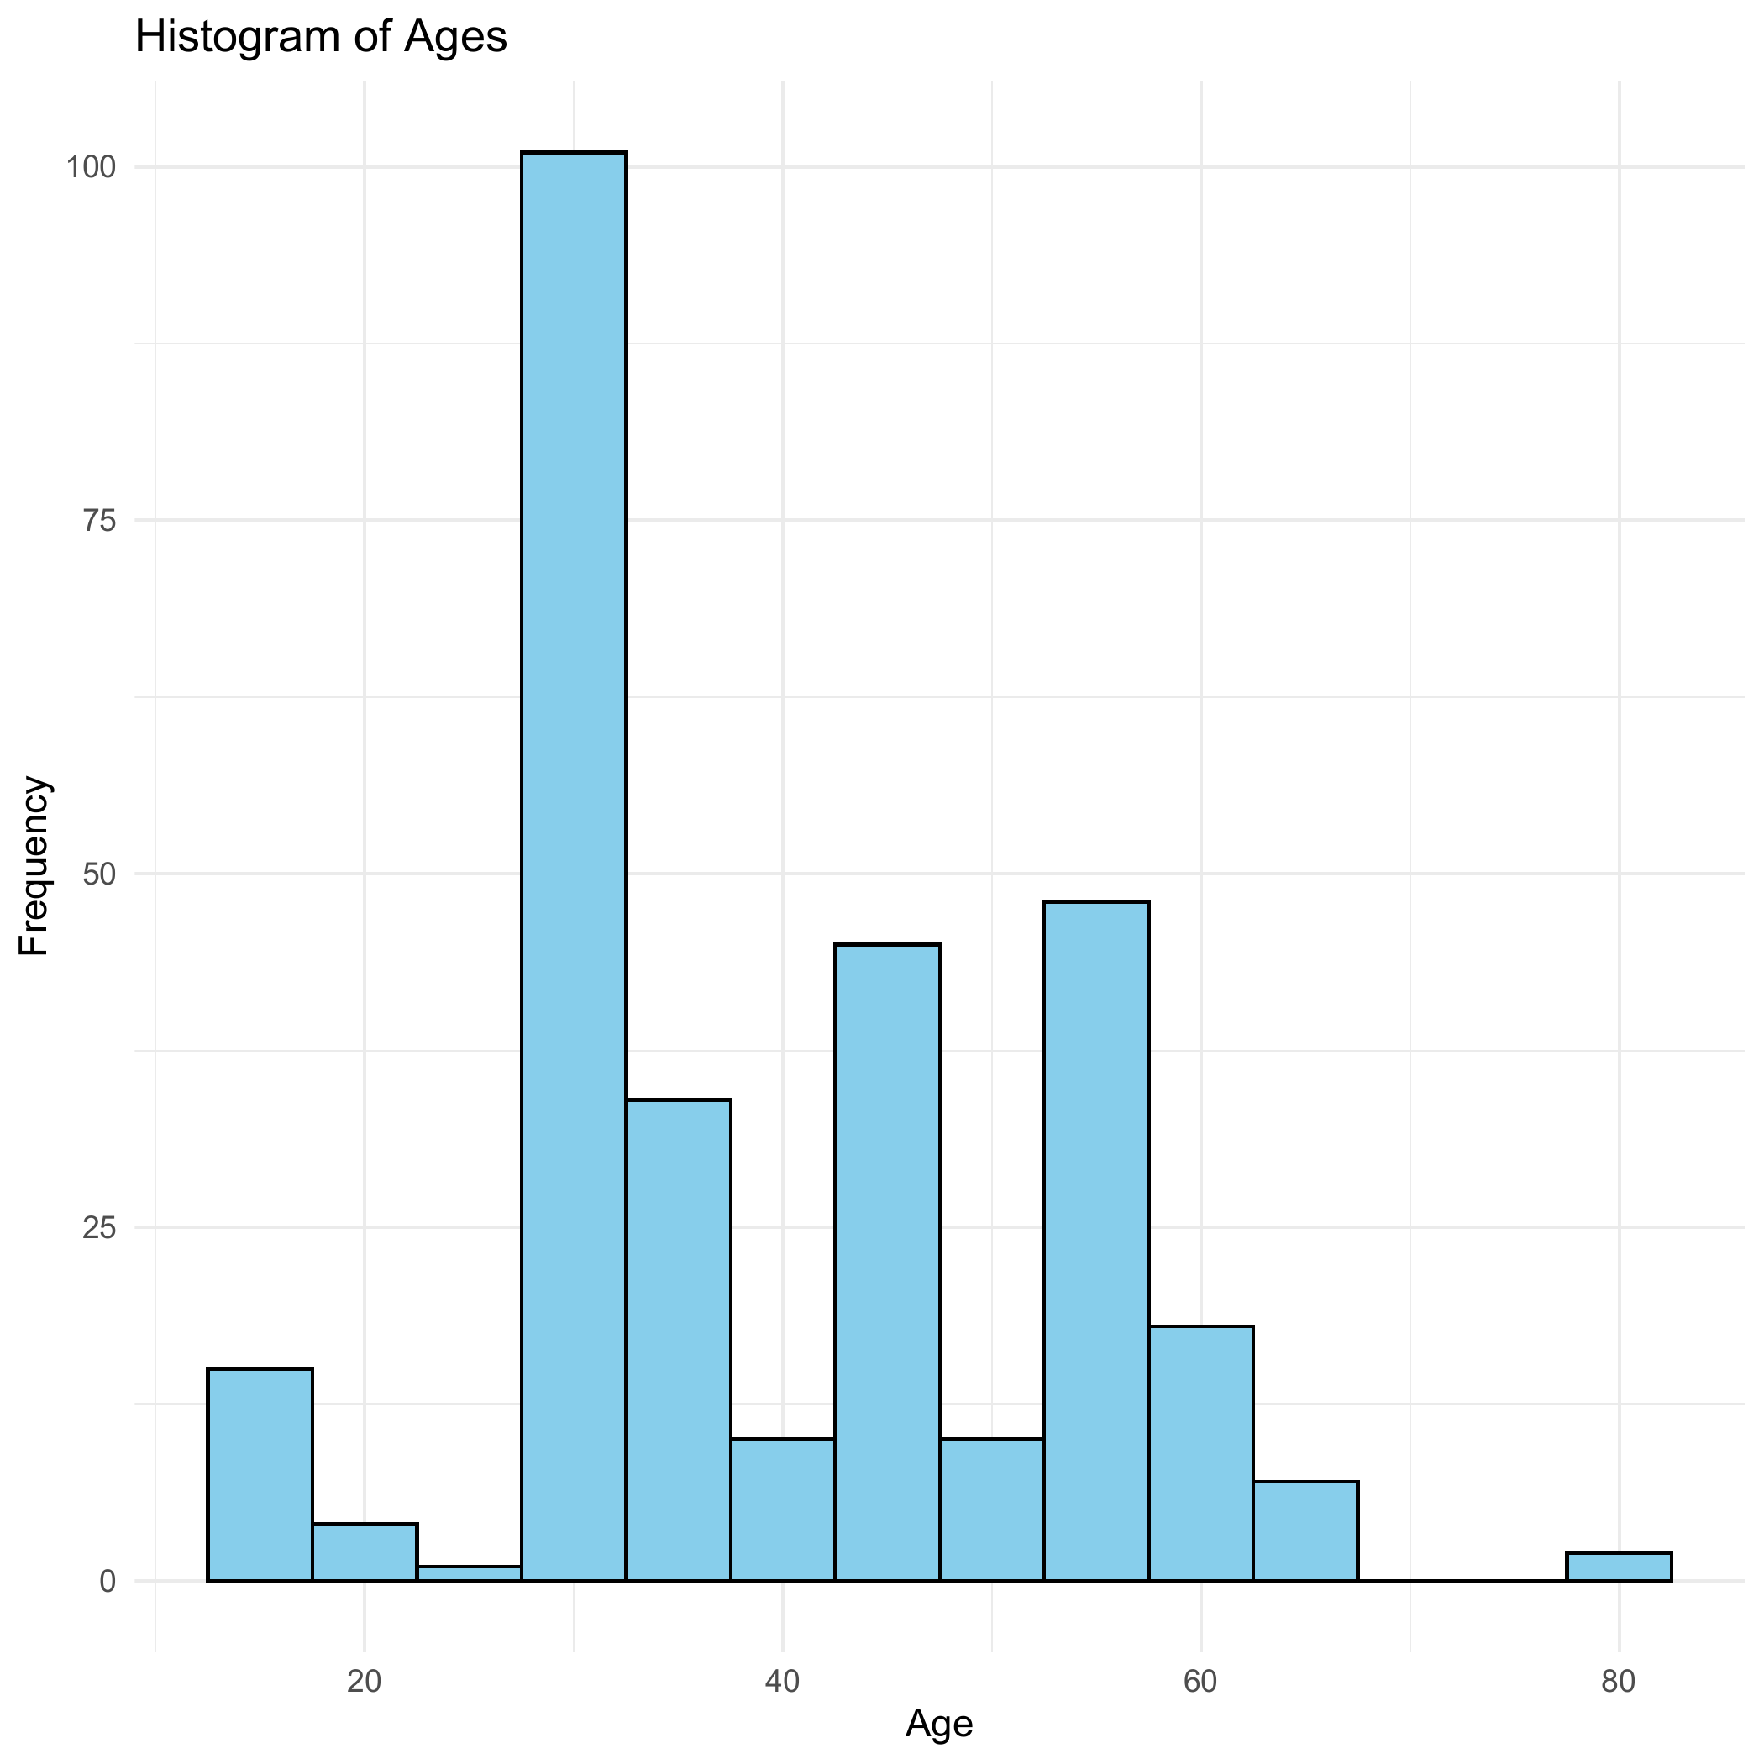
Histogram of Ages
@myhqtoronto | hqtoronto.ca | hqtoronto.ca/donate

Slide 7
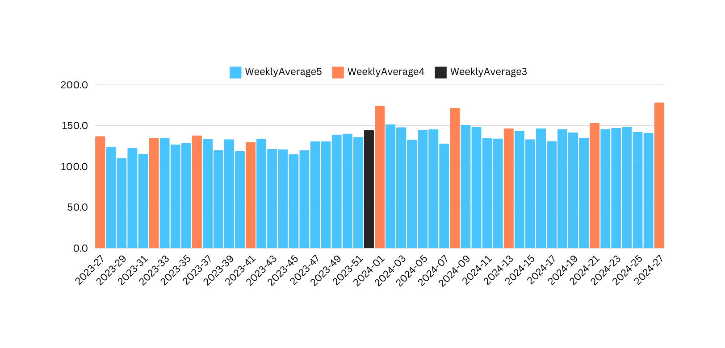
Average Weekly
July 2023 - June 2024
Christmas / Boxing Day
Canada Day
Civic Holiday
Labour Day
Thanksgiving
New Year
Family Day
Good Friday
Victoria Day
Canada Day
@myhqtoronto | hqtoronto.ca | hqtoronto.ca/donate

Slide 8






Demographics
July 2022 to June 2024
Average age of 34
10% living with HIV
Cis men: 87%
Trans men: 0.9%
Trans women: 1.4%
Non binary: 5.6%
Other gender identity : 1.5%
@myhqtoronto | hqtoronto.ca | hqtoronto.ca/donate

Slide 9

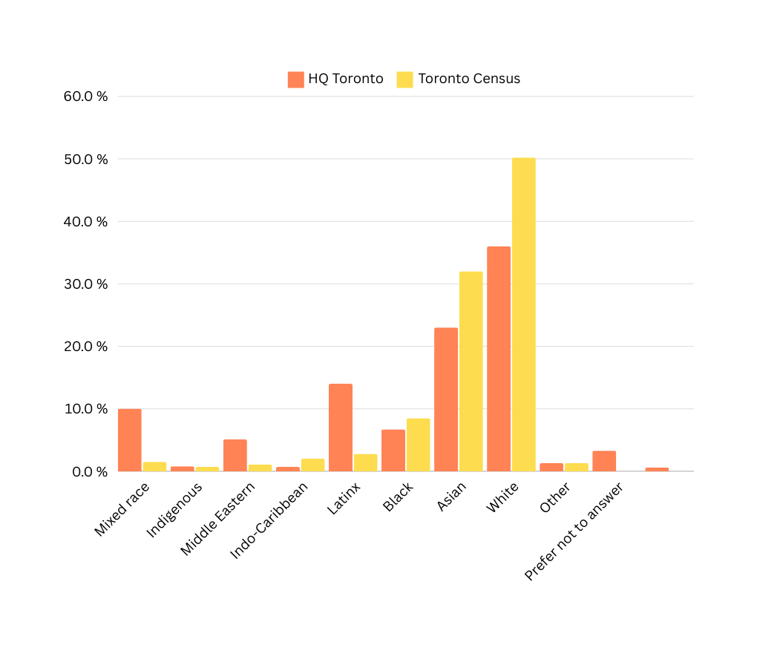
Ethnicity by individuals
July 2022 to June 2024
@myhqtoronto | hqtoronto.ca | hqtoronto.ca/donate

Slide 10
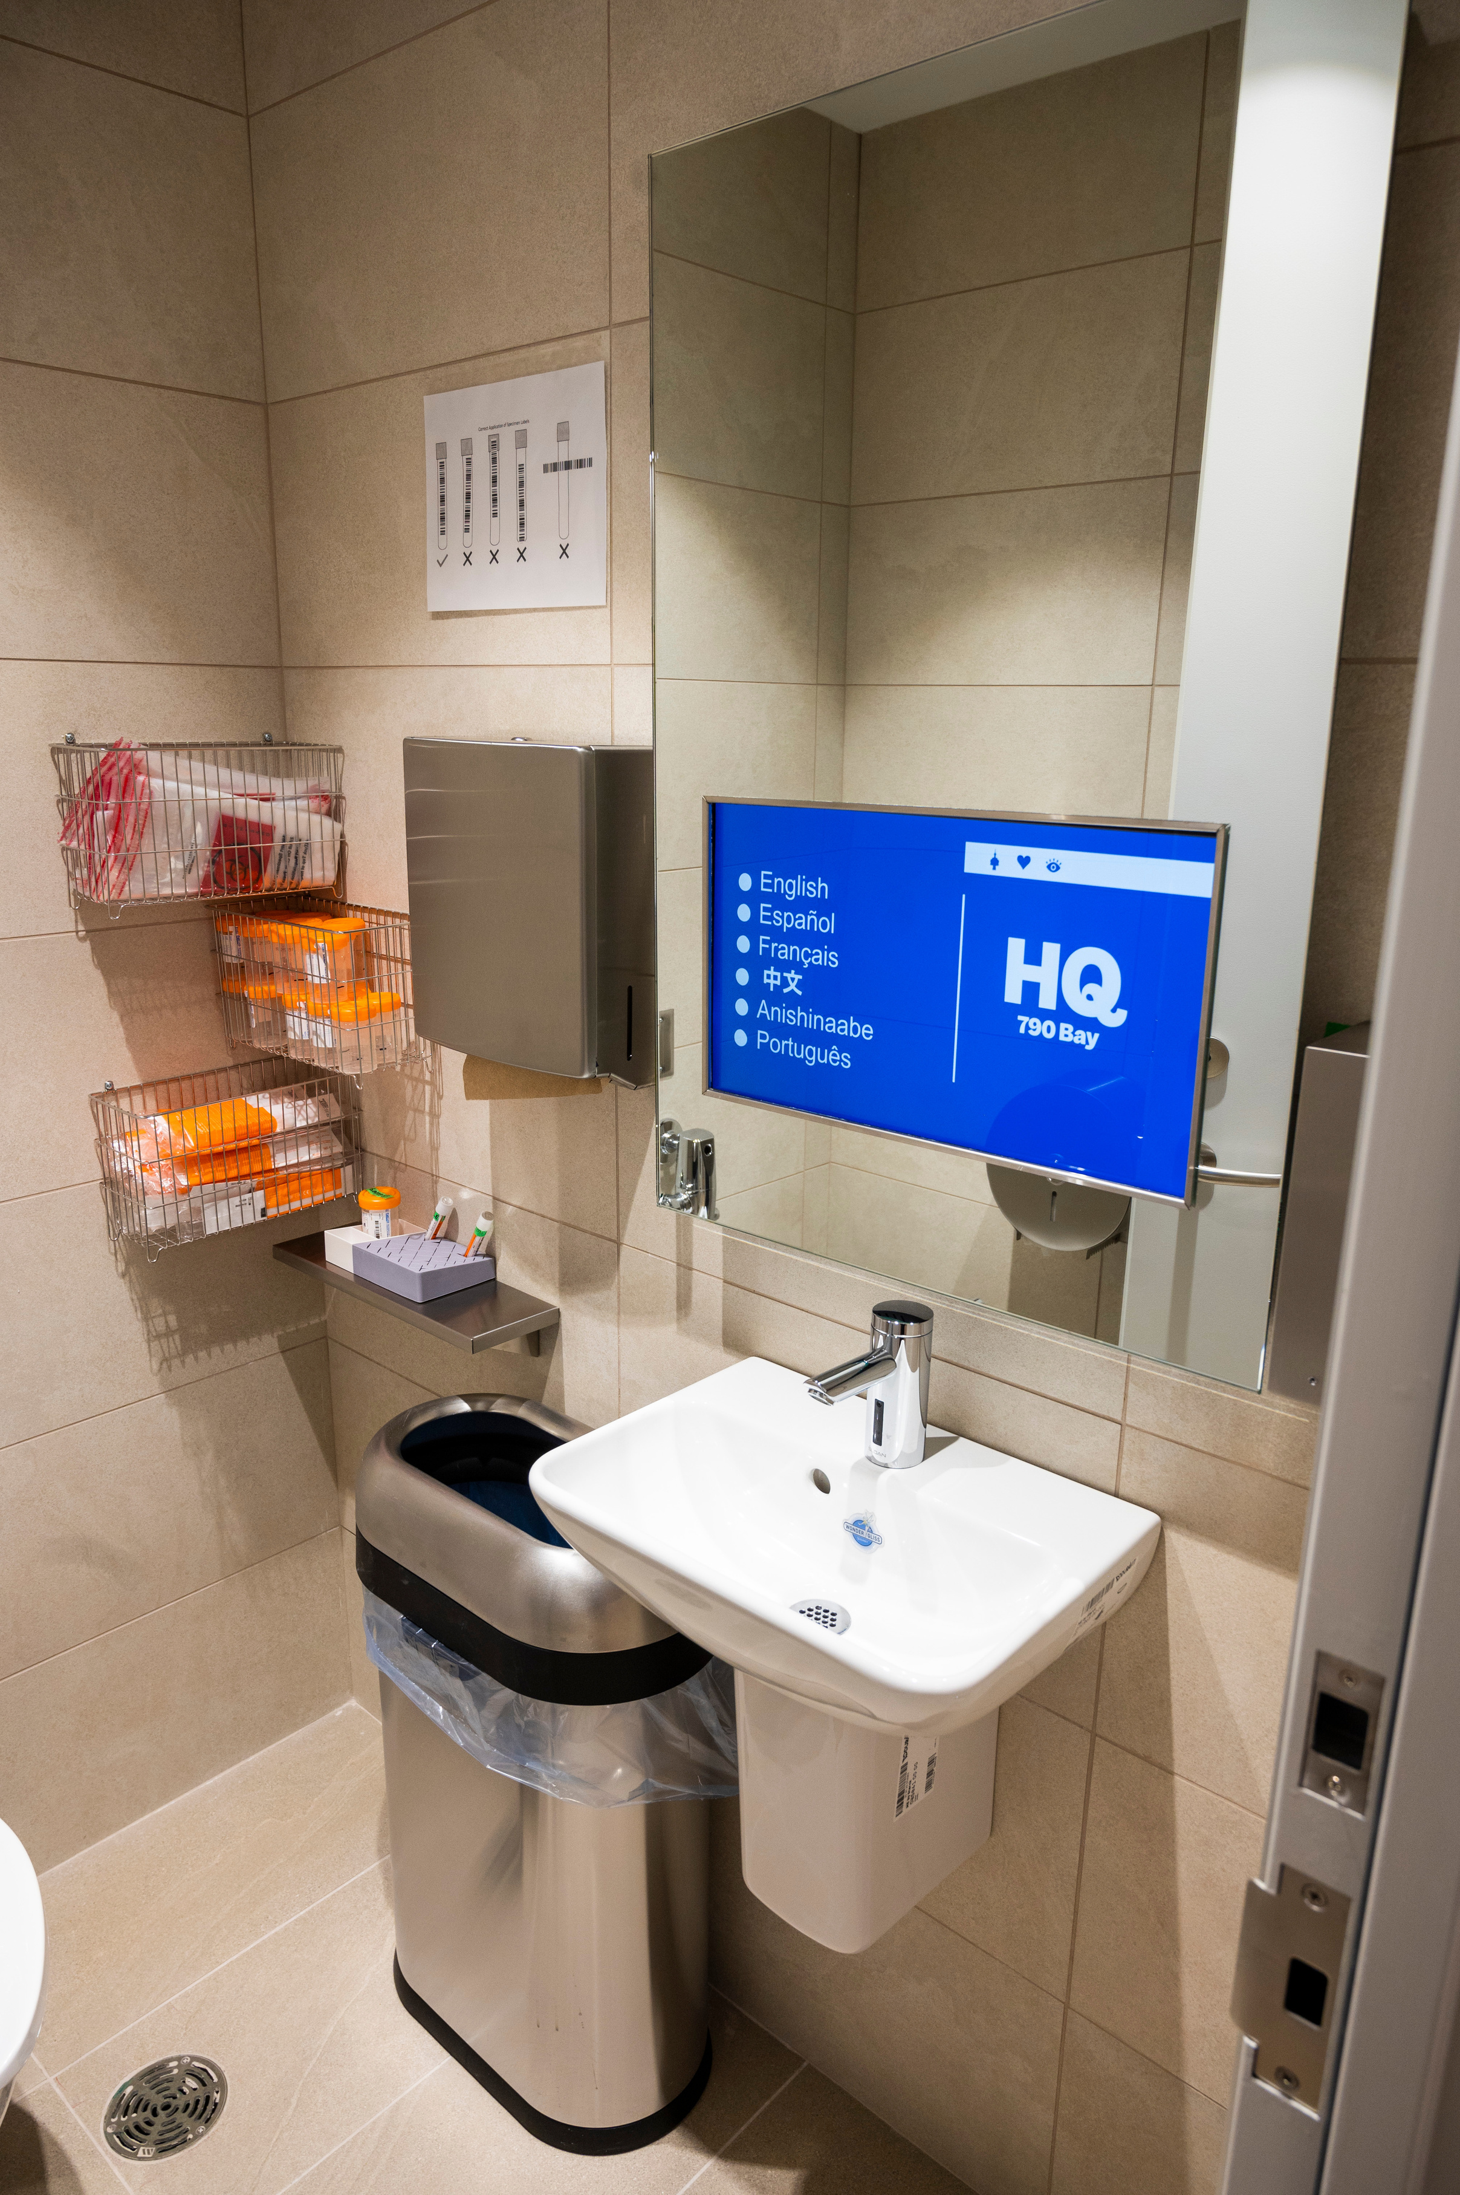
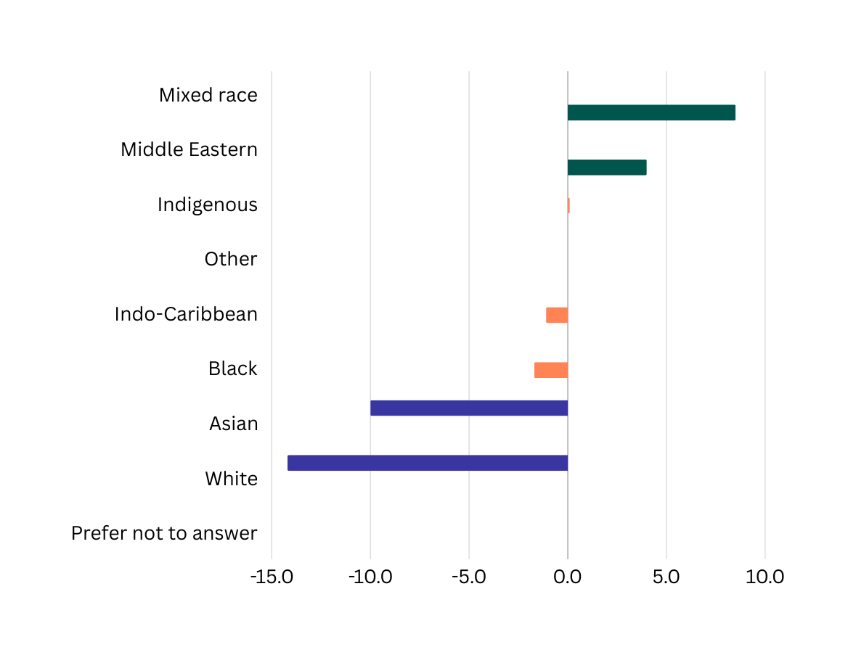

Ethnicity
(Difference between Toronto 2020 Census and HQ
<Toronto Census
= Toronto Census
> Toronto Census

Slide 11
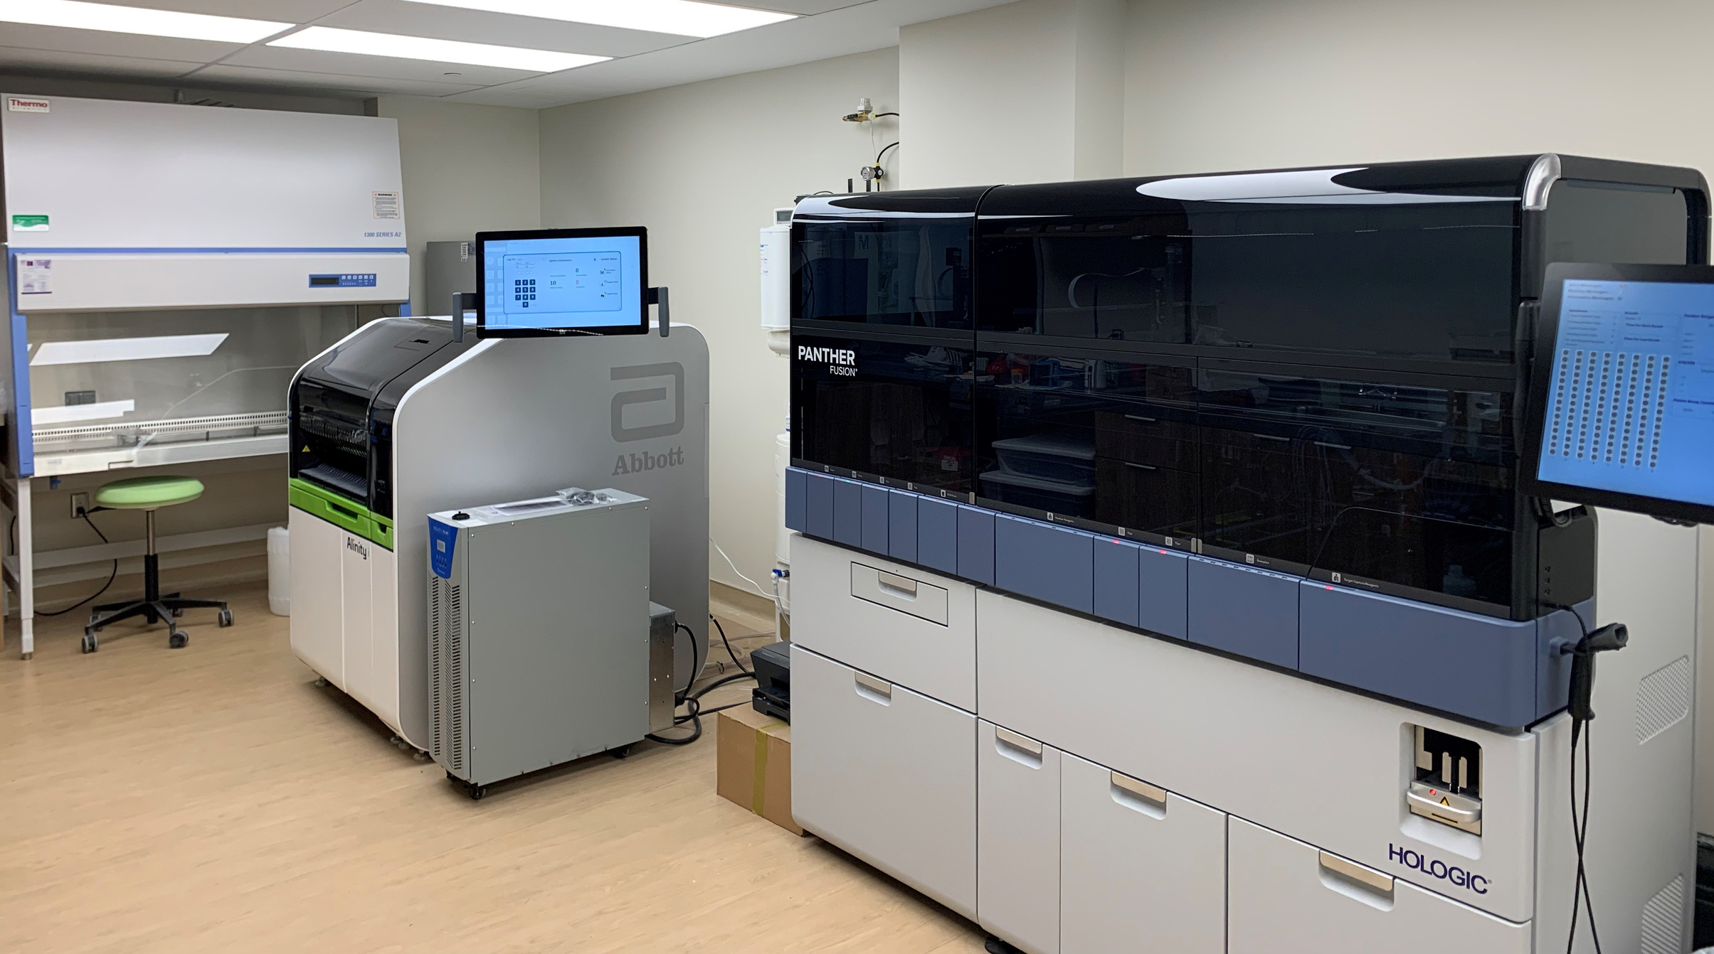
Improving the Health of Our Community
239,720 Test results
39,234 Treatment
@myhqtoronto | hqtoronto.ca | hqtoronto.ca/donate

Slide 12
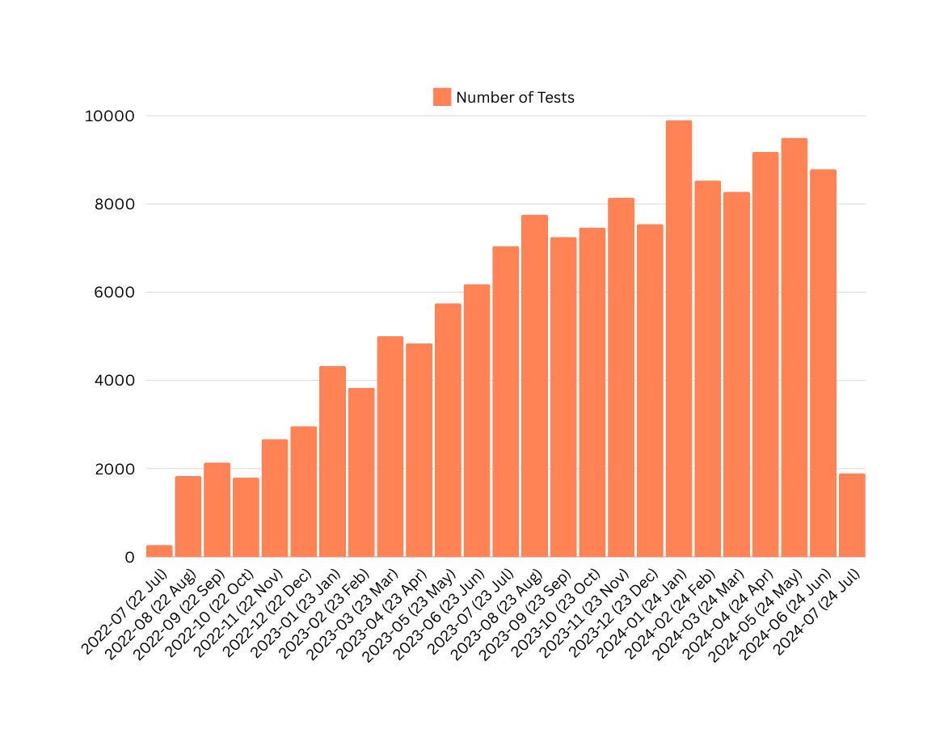
{{{{{{{{{{{{
STBBI Testing- Overall
Overall Numbers
@myhqtoronto | hqtoronto.ca | hqtoronto.ca/donate

Slide 13
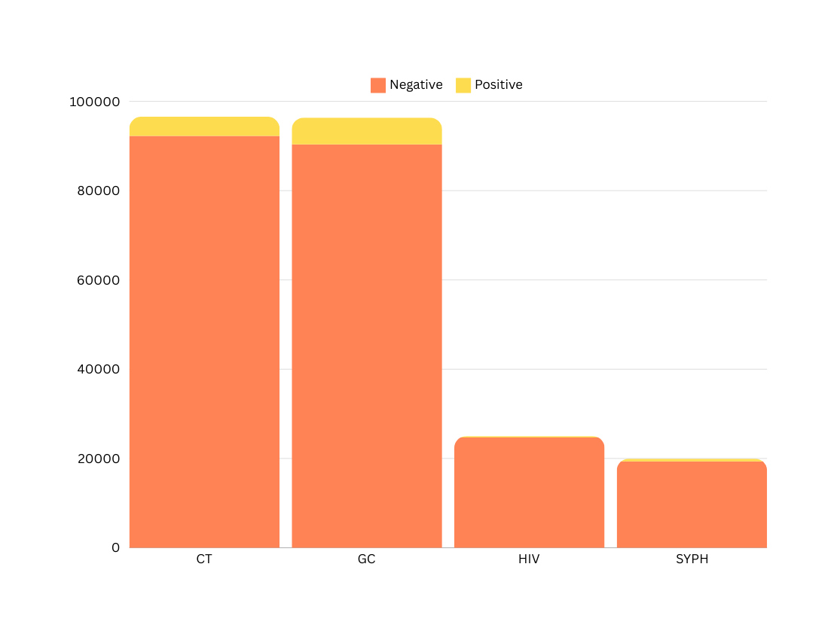
{{{{{{{{{{{{
STBBI Testing
4303
6017
318
606
@myhqtoronto | hqtoronto.ca | hqtoronto.ca/donate

Slide 14
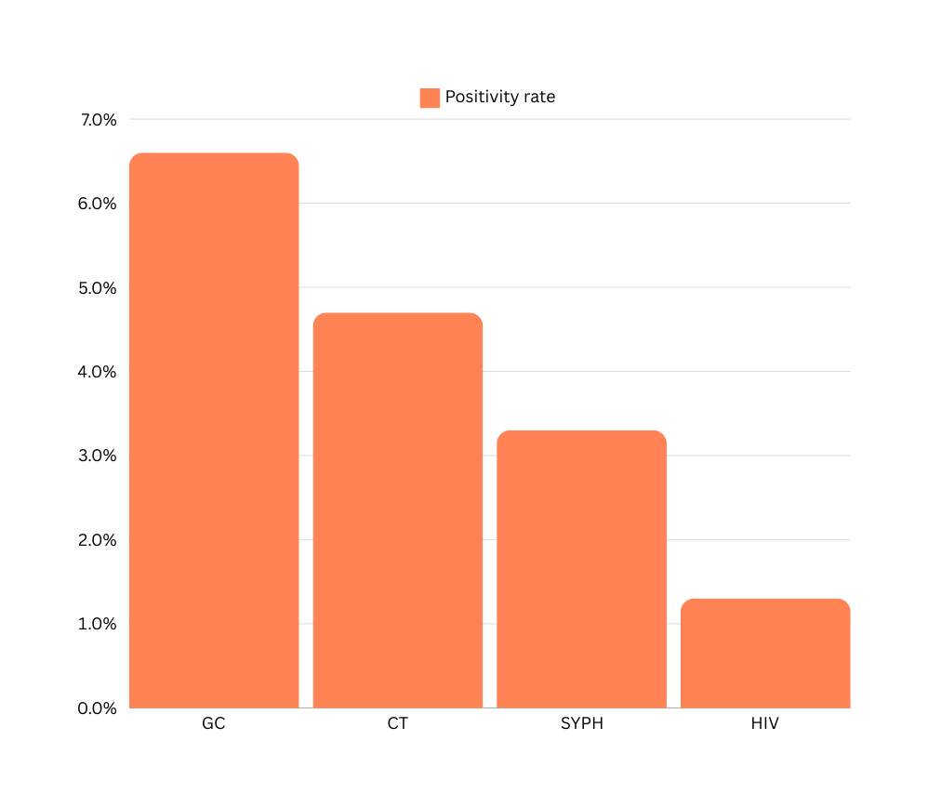
{{{{{{{{{{{{
Positivity Rate
July 2022-June 2024
6.2%
4.5%
3.0%
1.3%
@myhqtoronto | hqtoronto.ca | hqtoronto.ca/donate

Slide 15
{{{{{{{{{{{{
June 2024
Per Test Cost
 | Cost / Test | Test Volumes | Labour cost / Test | July Total Cost / Test
HIV Ag/Ab Combo Assay | $1.85 | 1618 | $ 2.39 | $ 4.24
Syphilis TP Assay | $ 1.34 | 1293 | $ 2.39 | $ 3.73
Aptima Combo 2 | $9.50 | 5868 | $ 2.39 | $ 11.89
HIV-1 QuantDx | $25.00 | 12 | $ 2.39 | $ 27.39
@myhqtoronto | hqtoronto.ca | hqtoronto.ca/donate

Slide 16
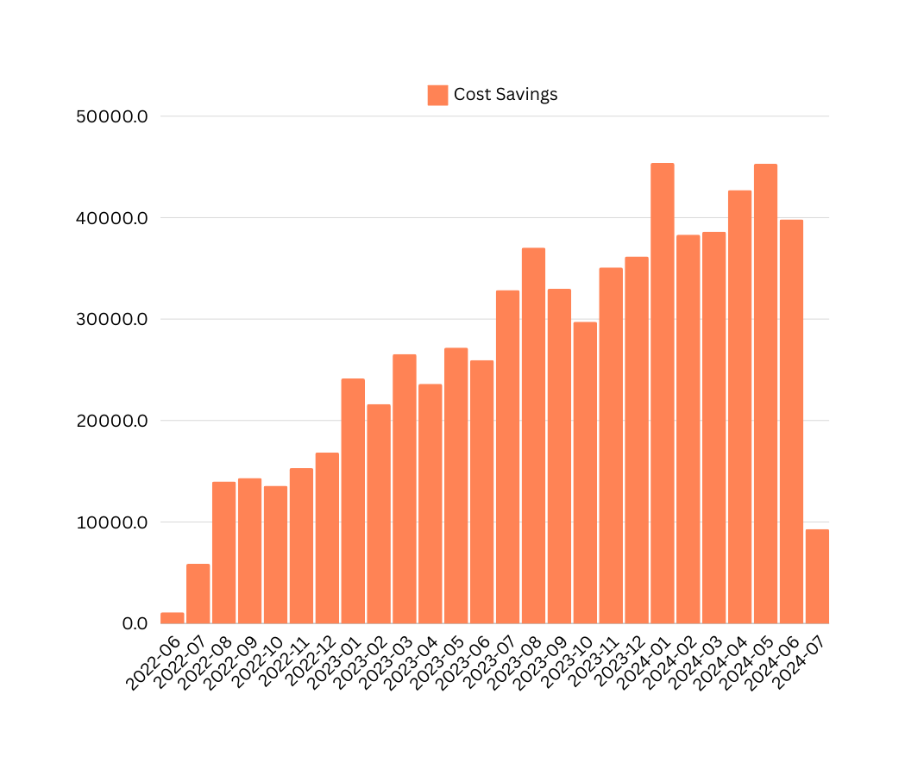
Monthly Cost Savings from Express Testing
Total cumulative savings to-date
$538,282
@myhqtoronto | hqtoronto.ca | hqtoronto.ca/donate

Slide 17

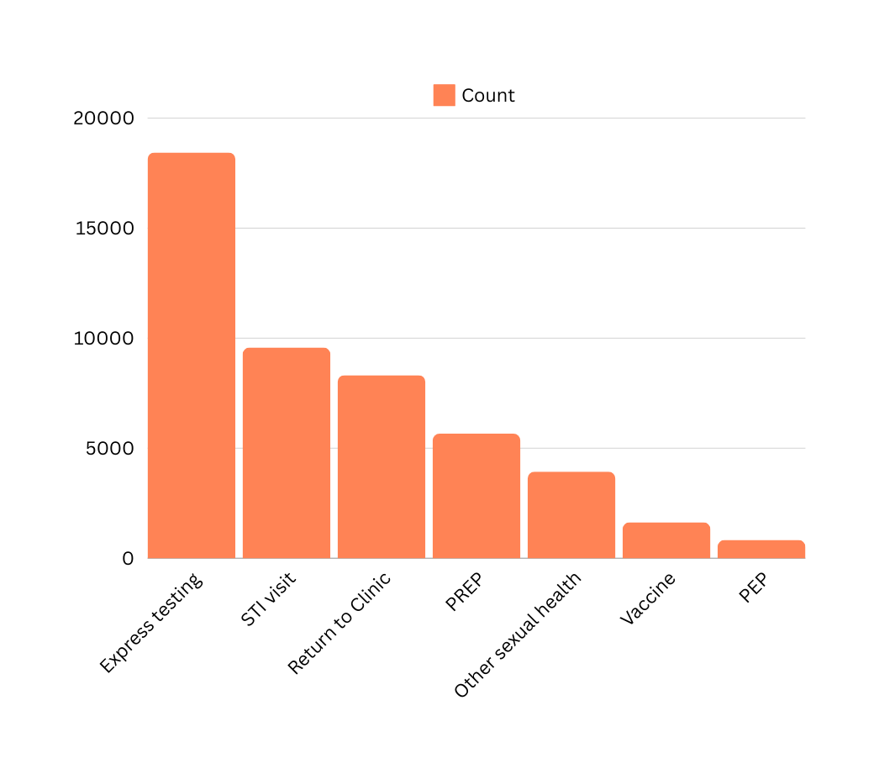
Reasons for Visit
July 2022 - June 2024
What individuals indicate on the kiosk as the reason for their visit
@myhqtoronto | hqtoronto.ca | hqtoronto.ca/donate

Slide 18

Unmet STBBI Needs
July 2022 - June 2024
2150 uninsured or precariously insured individuals accessing care at HQ (no OHIP or IFH)
2028 STBBIs diagnosed and treated amongst uninsured individuals
1321 gonorrhea or chlamydia
604 syphilis
2770 treatments given to 1212 service users (includes empiric treatments)
@myhqtoronto | hqtoronto.ca | hqtoronto.ca/donate

Slide 19

Unmet HIV Needs
July 2022 - June 2024
330 individuals with no OHIP, living with HIV receiving their HIV care at HQ
@myhqtoronto | hqtoronto.ca | hqtoronto.ca/donate

Slide 20

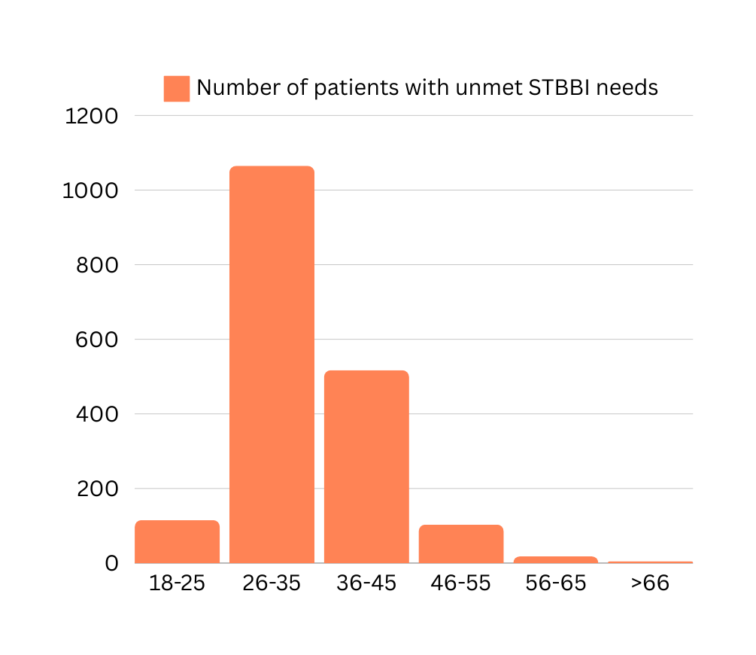
Unmet STBBI Needs: Age
Number of individuals
@myhqtoronto | hqtoronto.ca | hqtoronto.ca/donate

Slide 21

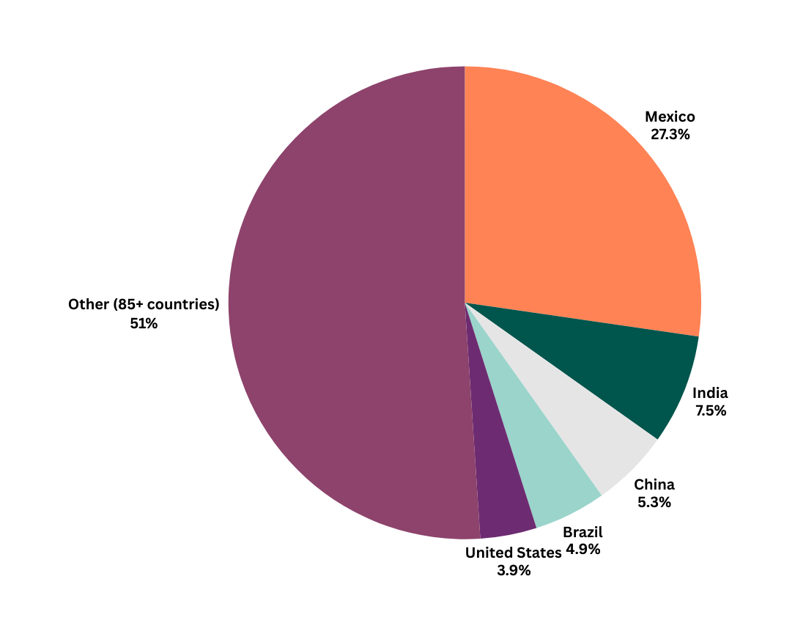
{{{{{{{{{{{{
Unmet STBBI Needs: Country of Origin
Other countries of origin (individuals): Ukraine, Saudi Arabia, Peru, Barbados, Thailand, Cyprus, Hungary, Venezuela, Germany, South Korea, Spain, France, Uganda, Nigeria, Guyana, Ghana, Panama, Australia, Jamaica, Pakistan
@myhqtoronto | hqtoronto.ca | hqtoronto.ca/donate

Slide 22
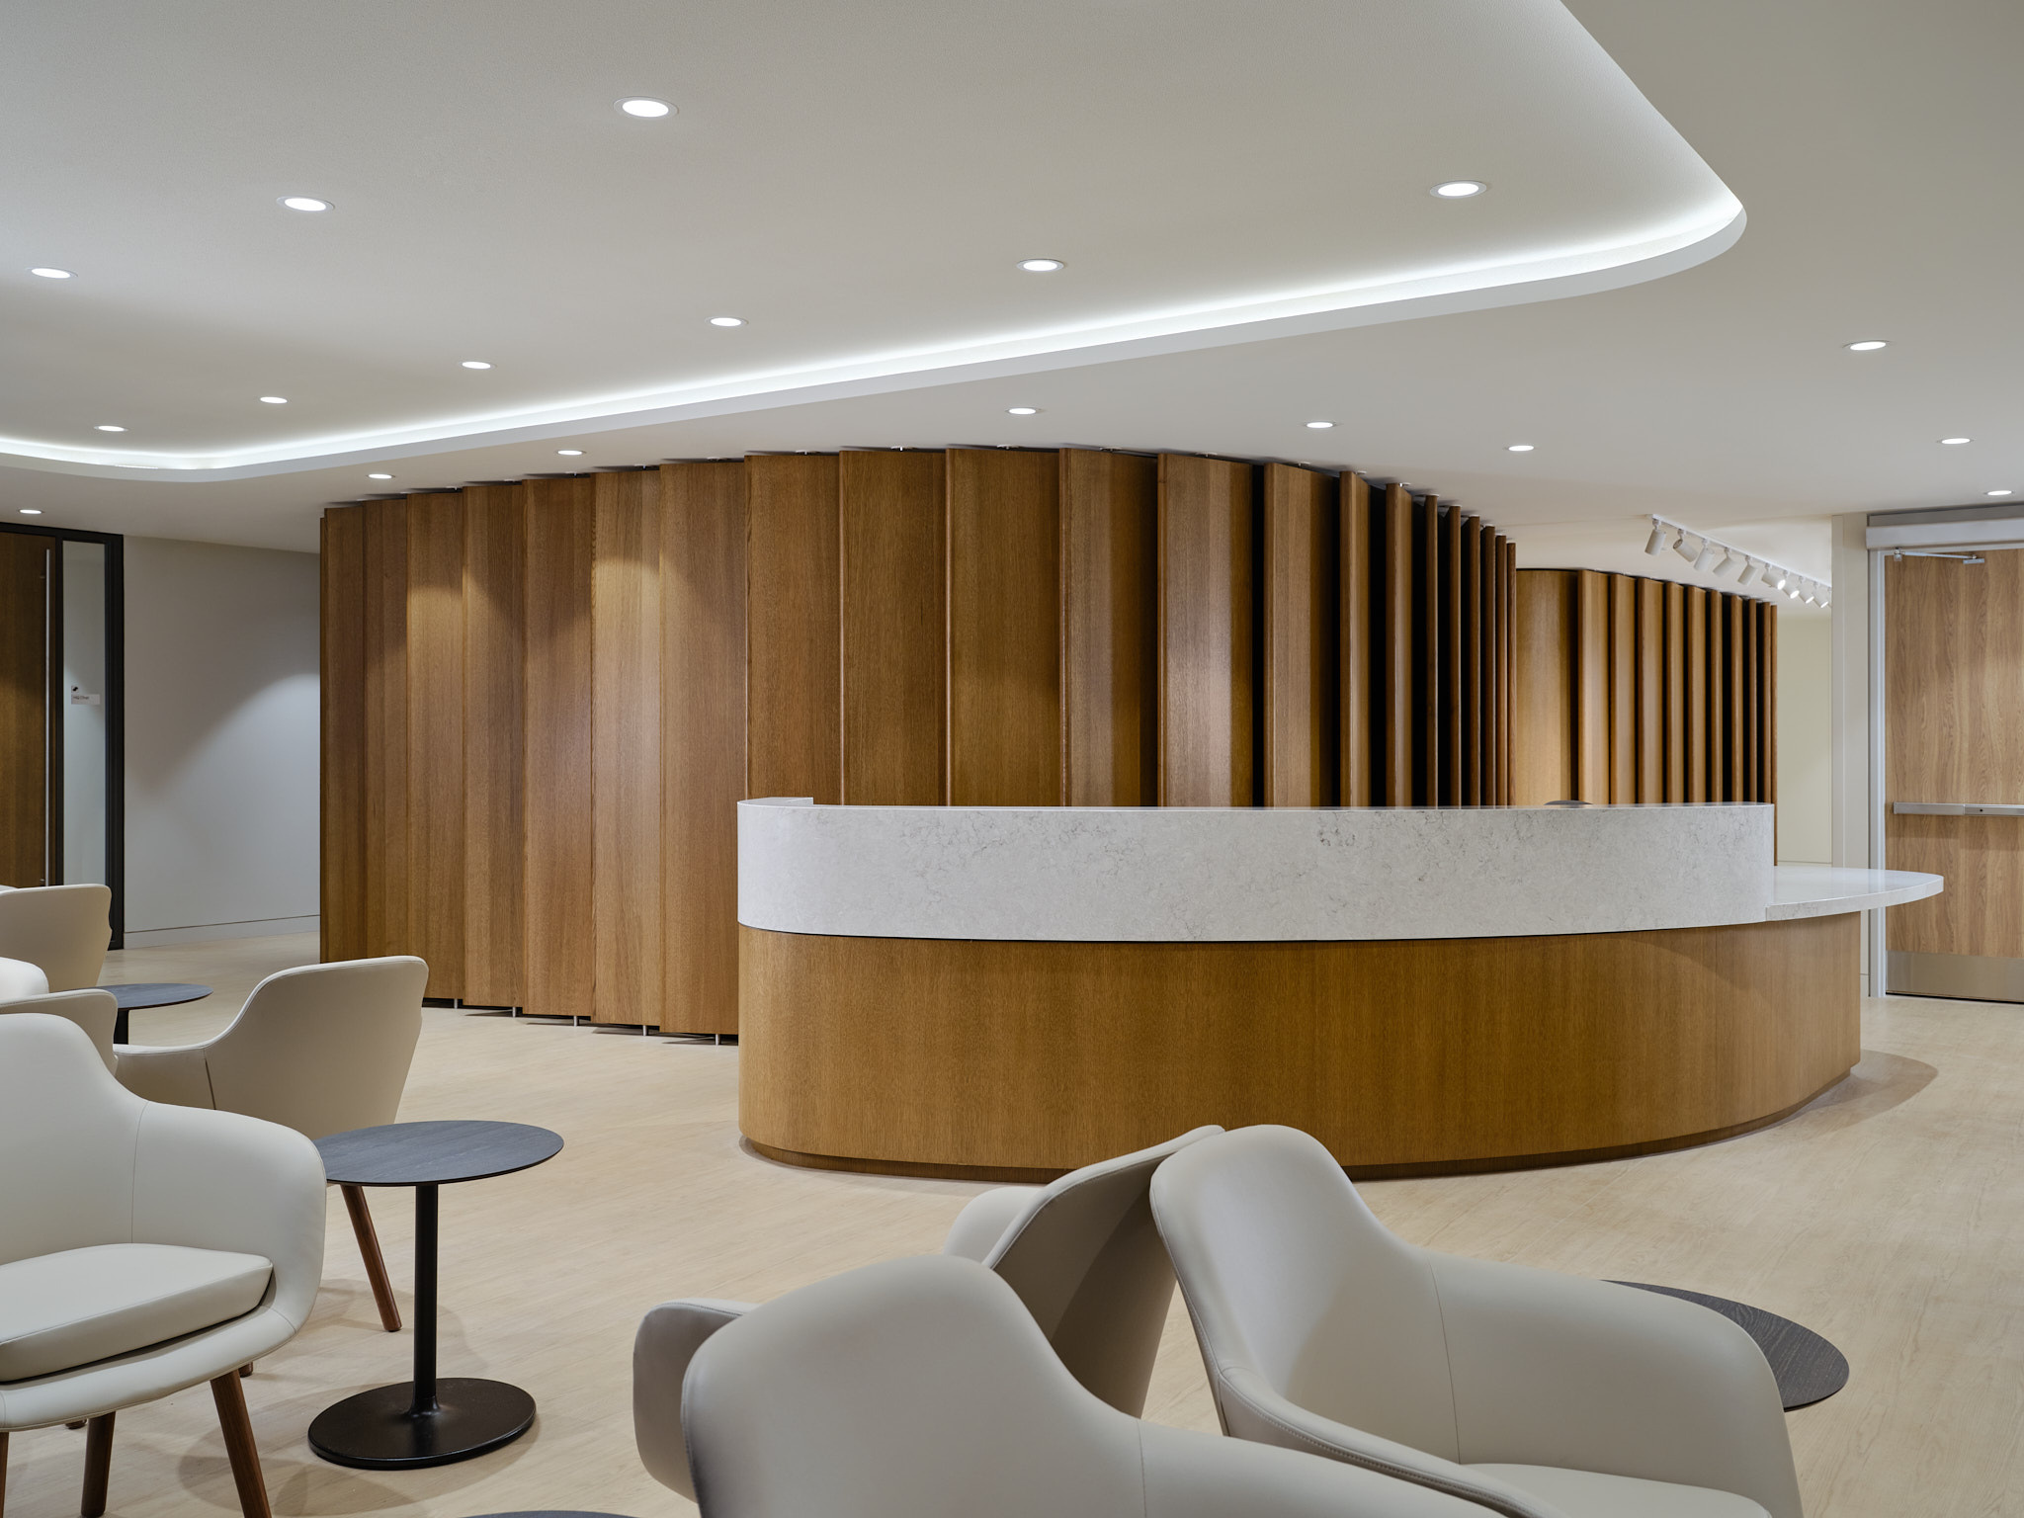
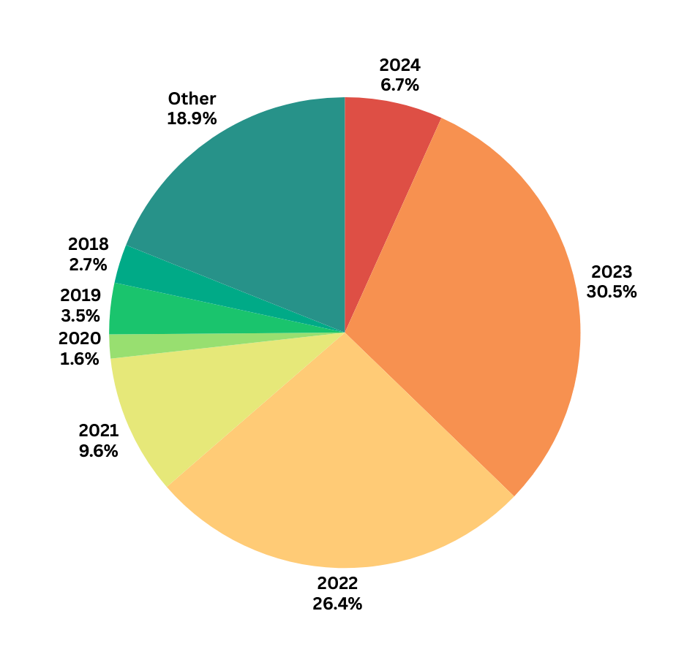
{{{{{{{{{{{{
Unmet STBBI Needs: Year of Arrival in Canada
@myhqtoronto | hqtoronto.ca | hqtoronto.ca/donate

